Slide 1




National Children’s Science Congress
Early Detection of Pandemics using AI driven Geospatial Analysis of School Attendance Data
Sub Theme: Technological Innovation for Ecosystem and Health (V)
Guide Teacher: Varun P K (PGT Physics) Team Leader: Krishnavyshak R Team Member: Aditya Narayan Pandey

Slide 2


Project
Objectives
01
Early Detection: Use AI to analyze school attendance data for early identification of potential pandemics.
The project aims to utilize AI-driven geospatial analysis of school attendance data to detect potential pandemics early, allowing for swift response by health authorities and enhancing community safety.
Geospatial Visualization: Map student attendance, generate heat maps, and highlight areas with high absenteeism.
02
Rapid Communication: Enable swift alerts to health authorities for quick and targeted responses to emerging health threats.
03

Slide 3
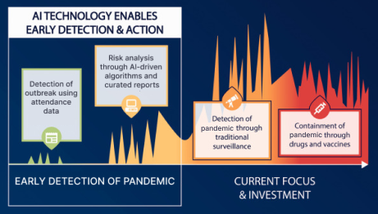

Slide 4



Significance of the project
Prevention
Significance
The project's preventive significance lies in its ability to proactively detect and alert health authorities to potential outbreaks, enabling timely interventions and safeguarding communities from the escalation of pandemics.
The project's significance lies in its advanced AI algorithms for early pandemic detection through school attendance analysis, geospatial visualization pinpointing high-risk areas, and swift communication with health authority for quick response.

Slide 5
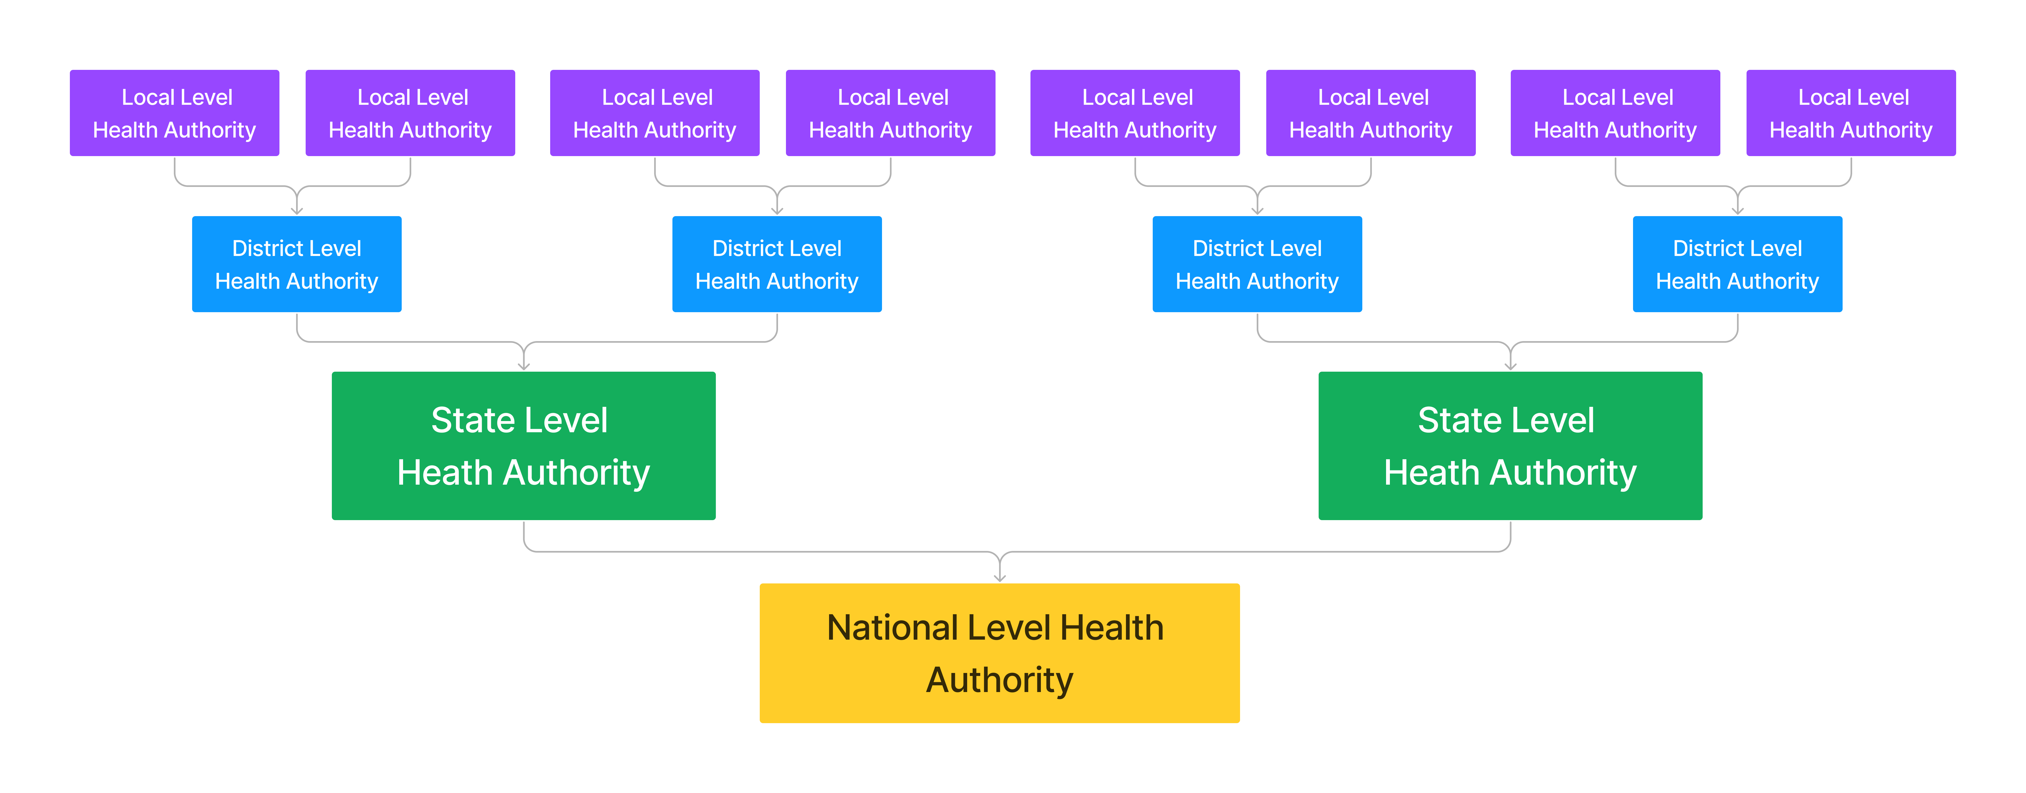

Slide 6

Pandemic Real-time Observation and Absentees Clustering Technique [PROACT] Algorithm
The PROACT Algorithm is the powerhouse behind our project, designed for keeping a close eye on potential pandemics within schools.
Key features:
Realtime monitoring of absentees’ data for detecting unusual pattern related to illness among students.
Clustering addresses of absent students.
Immediately alerting health authorities on detecting any anomalies.
Generating easy to understand heatmaps.

Slide 7


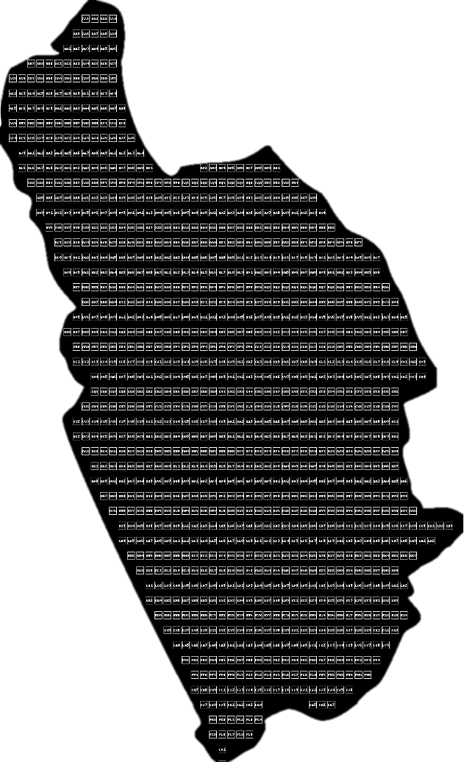

Procedure of the Algorithm
STEP 1
Making a plot of the area with girds dividing the whole area into several small pieces.
Naming each grid with a unique ID.

Slide 8
STEP 2
Collect the satellite and terrain view of the area using Google Maps API
STEP 3
Arrange all the layers of the map
STEP 4
Generating heatmap with address points of using real-time data of absent students.

Slide 9
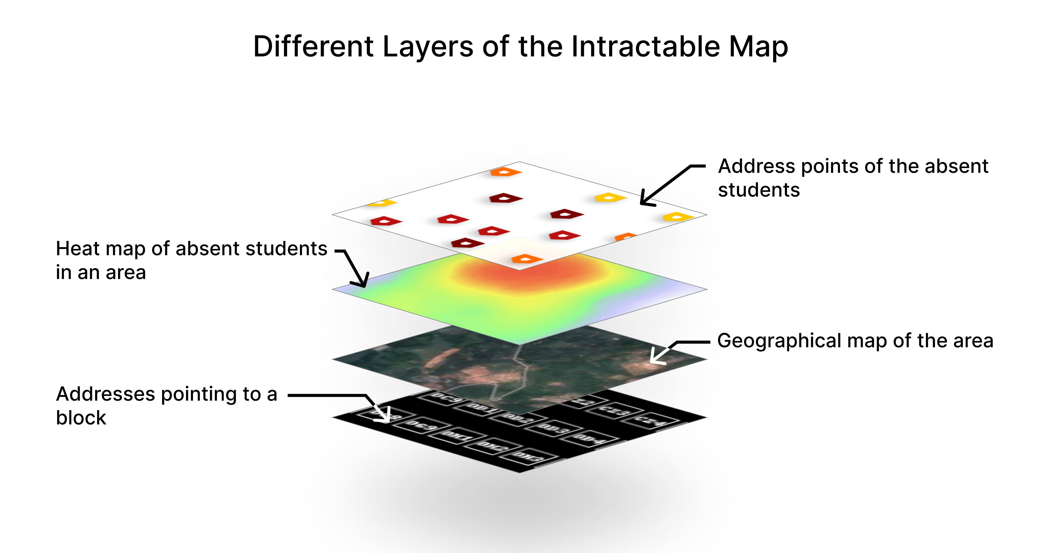

Slide 10
Working of the Web Interface
The web interface was built using React.js framework using Firebase as the database for storing the data of absent students. The web interface provides:
Intractable heatmaps
Address highlighting
Absentees' health records and contact information
Cluster & hotspot detection

Slide 11
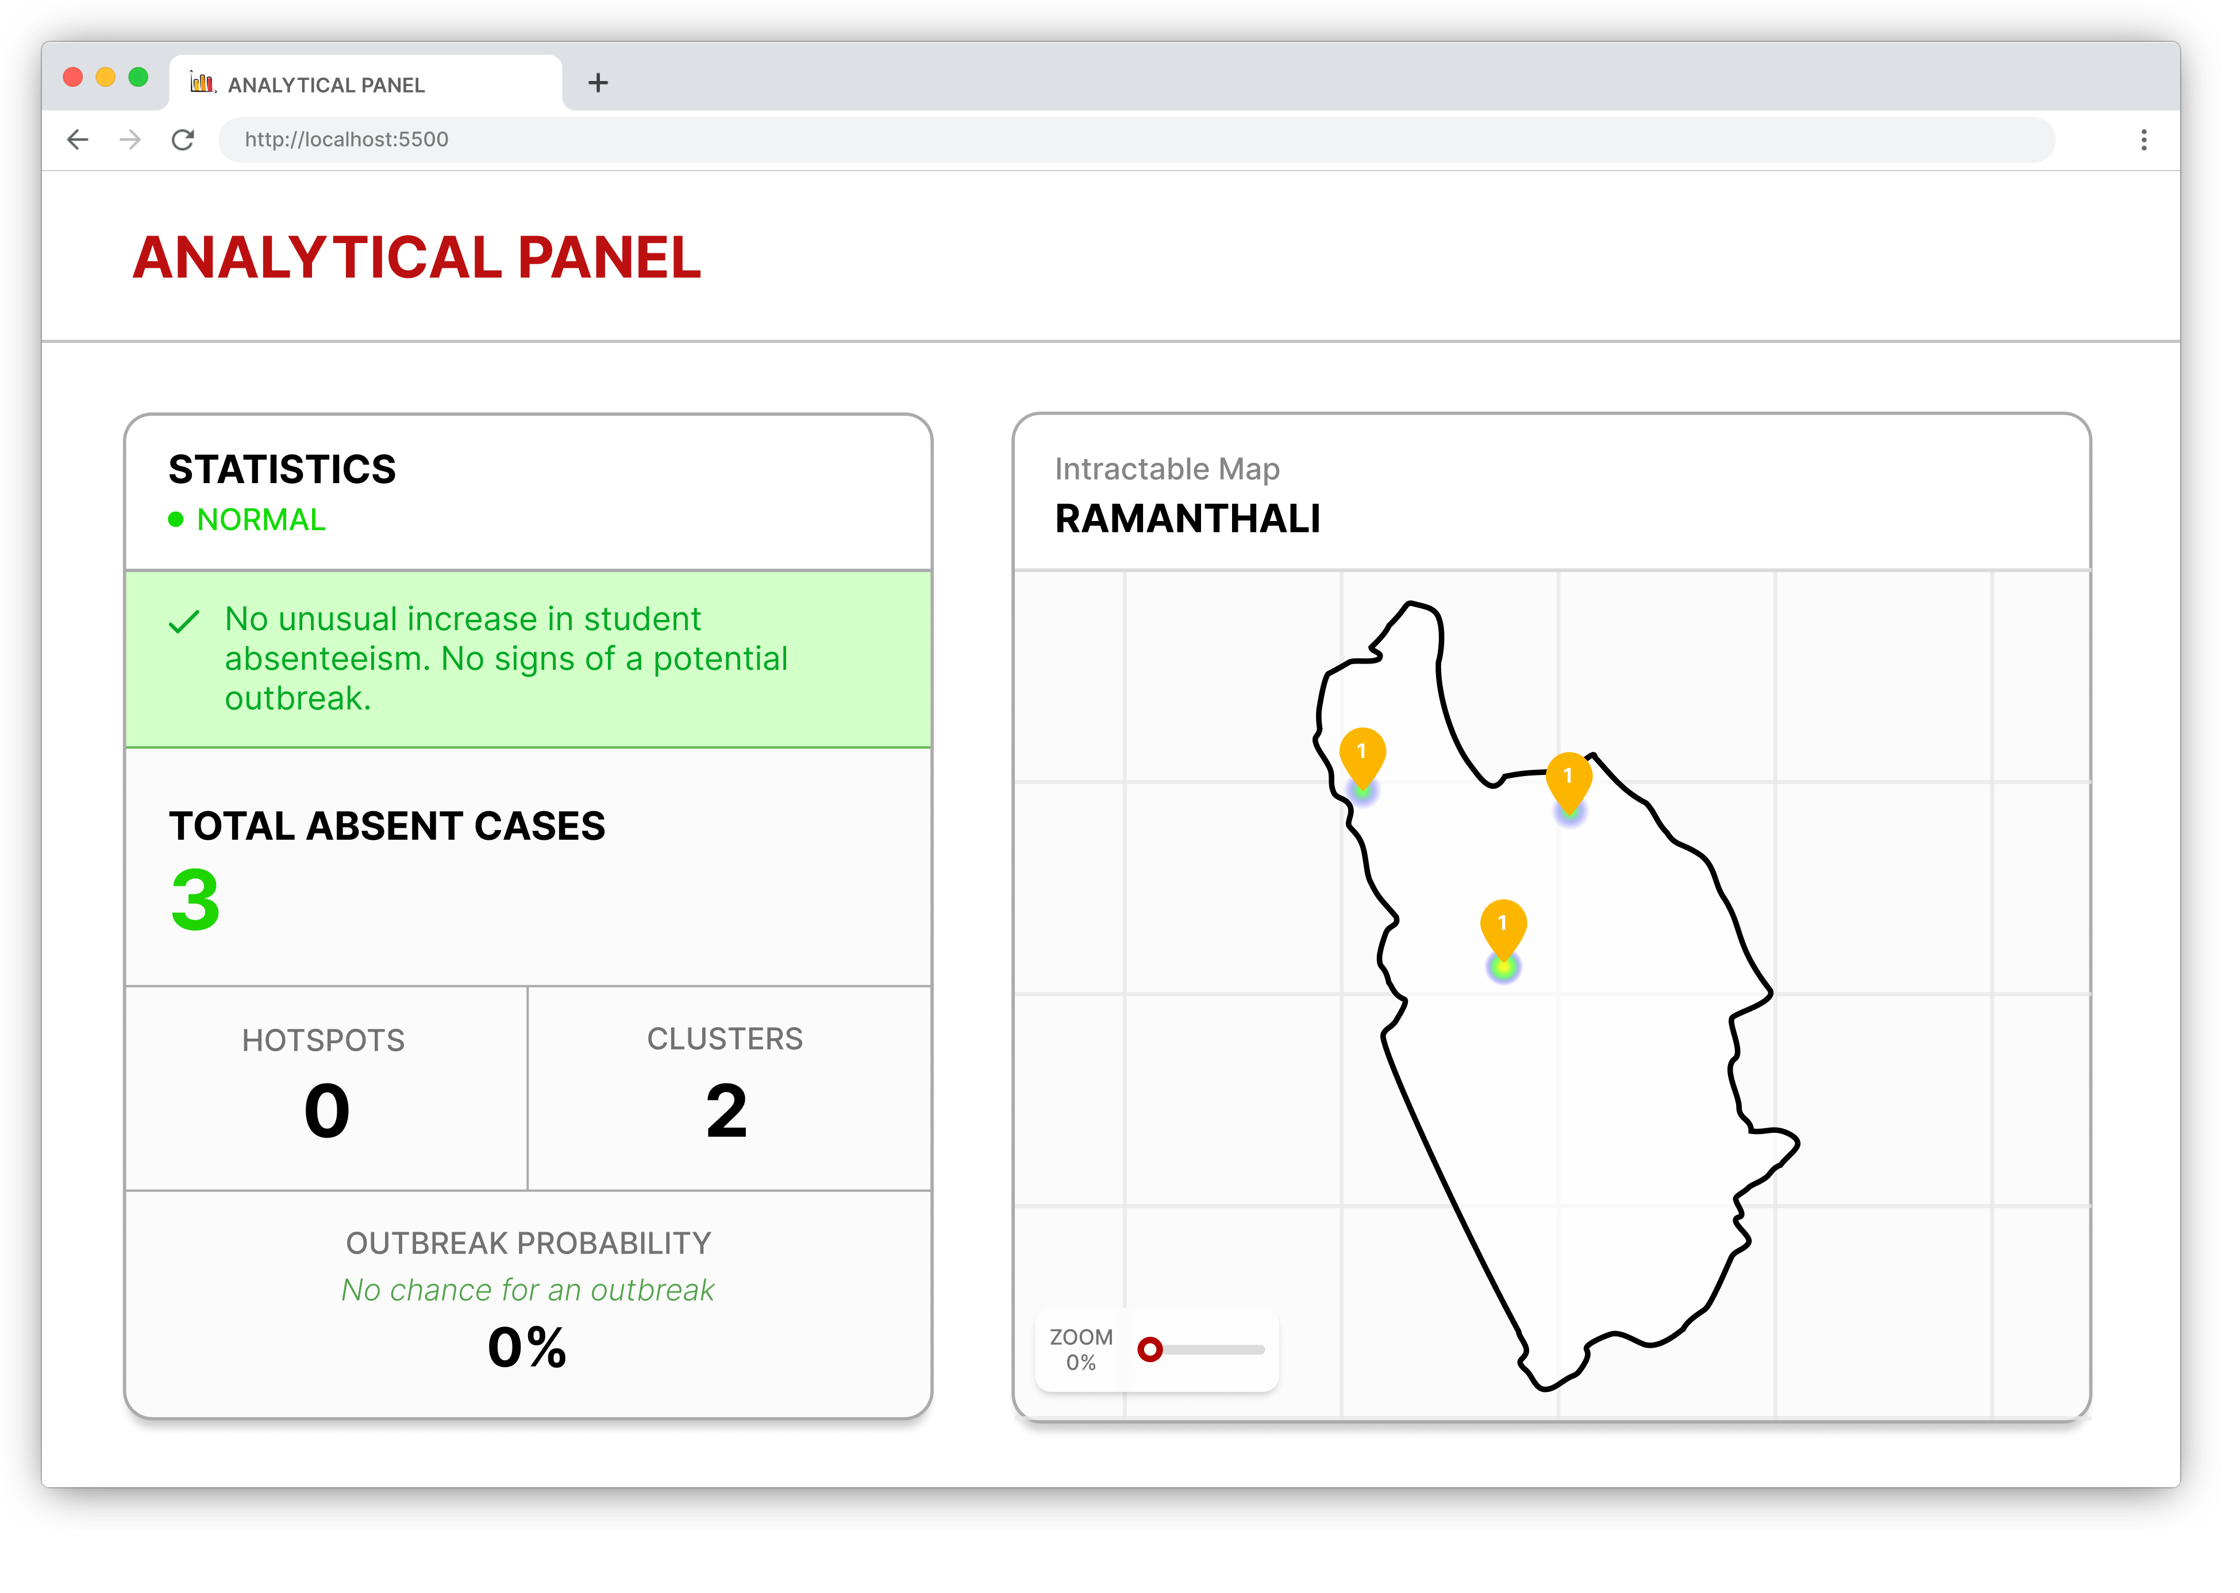

Slide 12
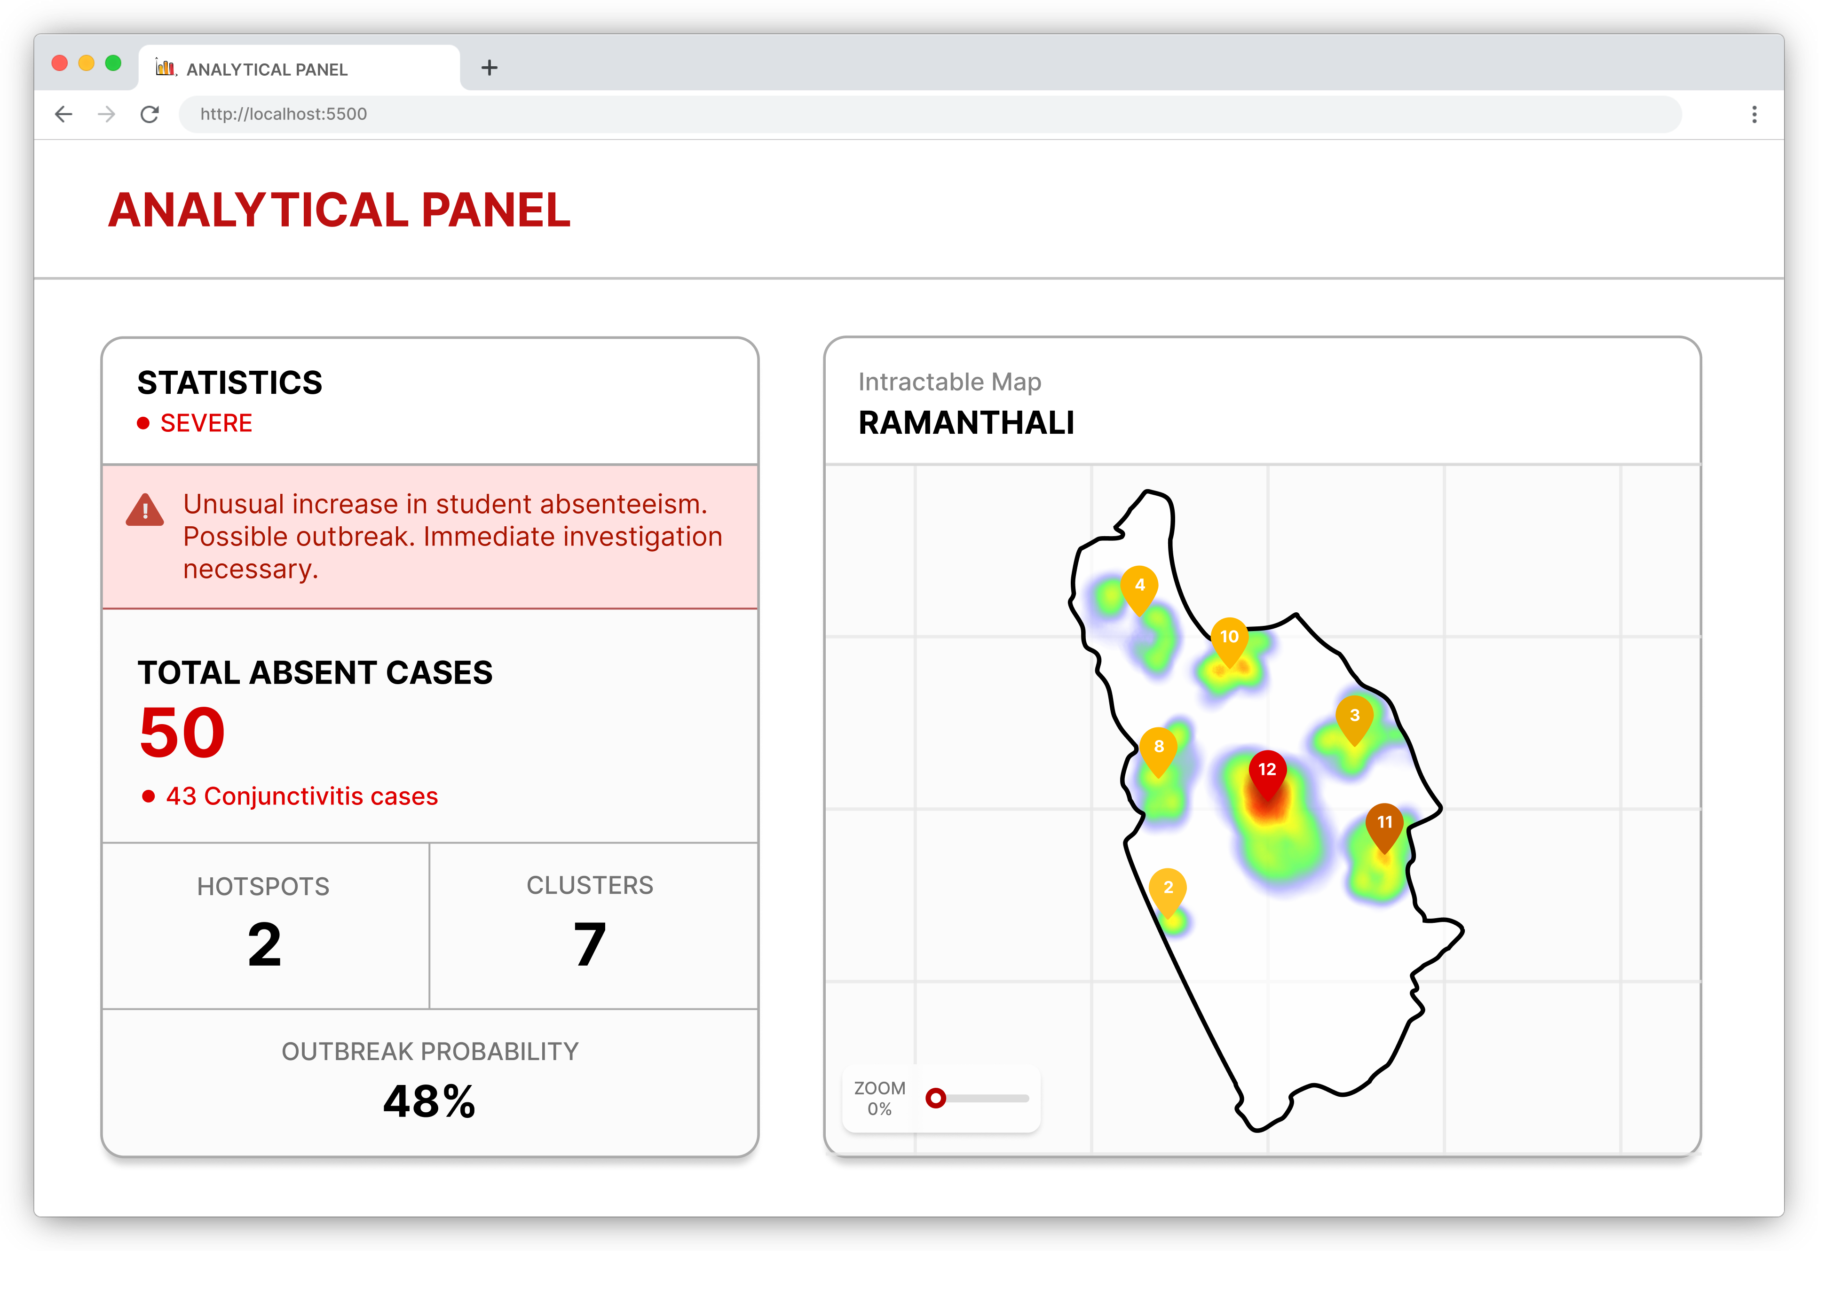

Slide 13
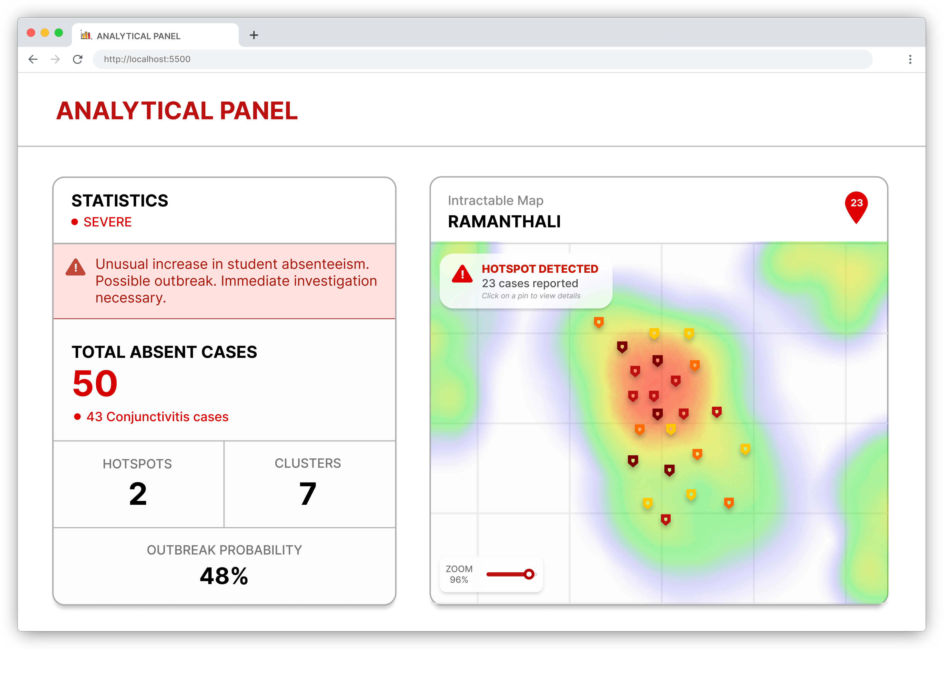

Slide 14
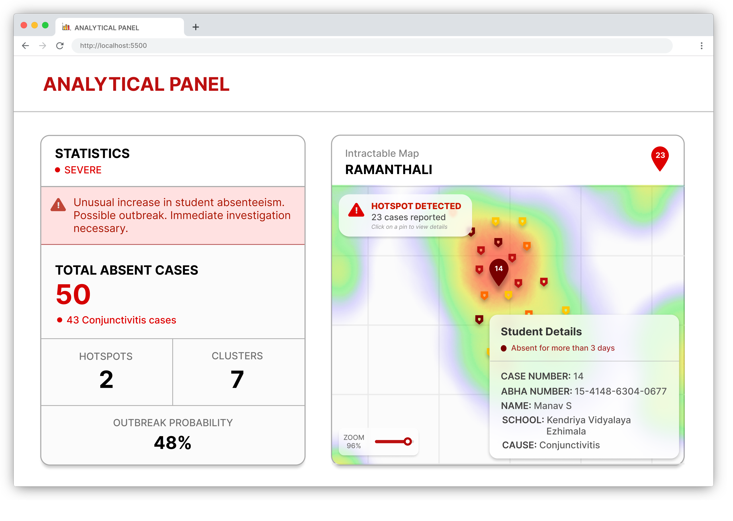

Slide 15
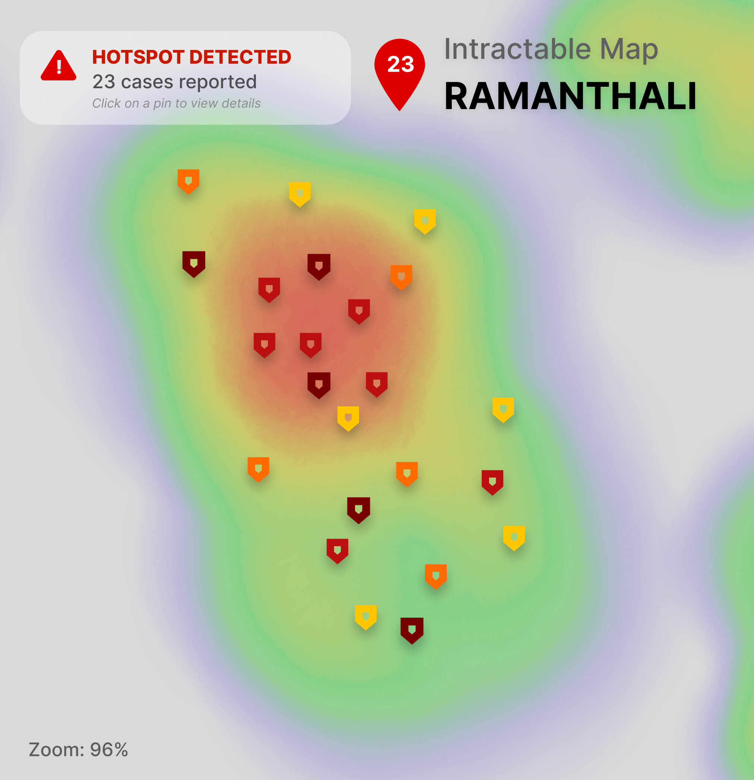
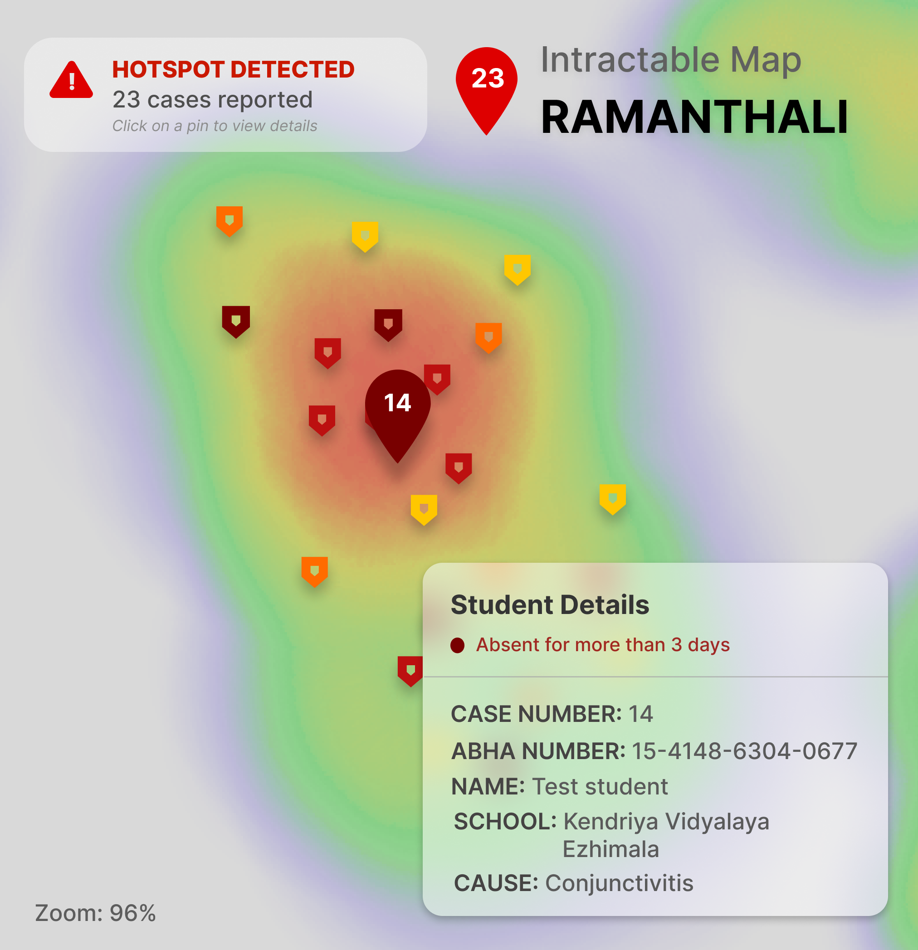

Slide 16
Working of the Mobile App
The Android app is built for the class teachers to feed the absentees’ data. The data is then sent to the firebase database.
The app also shows statistics of the absentees and graph of trend in absenteeism of the class, making it easy for the teacher to visualize.

Slide 17
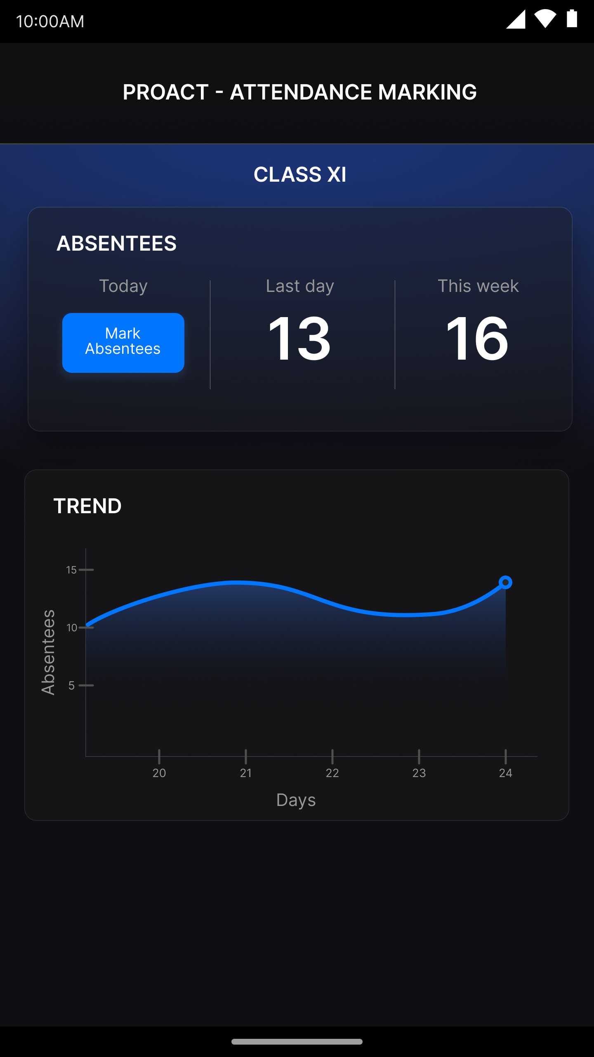

Slide 18
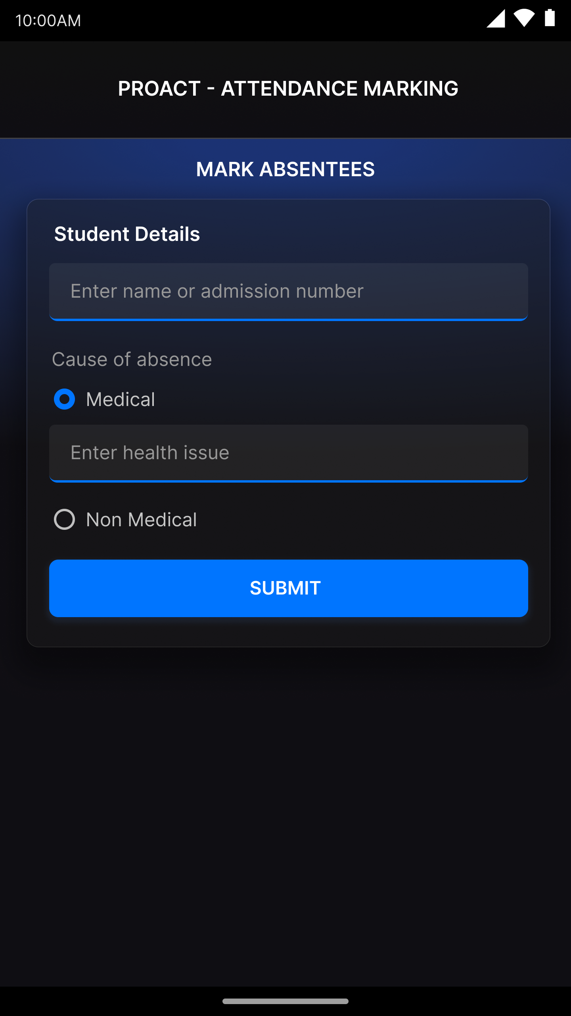

Slide 19
AI model
The AI model is the core of our project, which is responsible for predicting the change of an outbreak to plotting the heatmap and identifying the clusters.
The AI model was built using the RandomForest model for outbreak detection.
Susceptible-Infectious-Susceptible model was also used to find the chance of a student to get affected with the viral disease.
The AI model was trained on a large dataset which also consists trend of absentees during the dengue situation of 2018 in India.

Slide 20
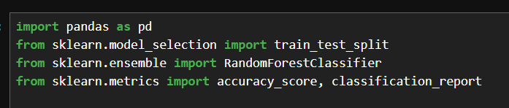

Slide 21
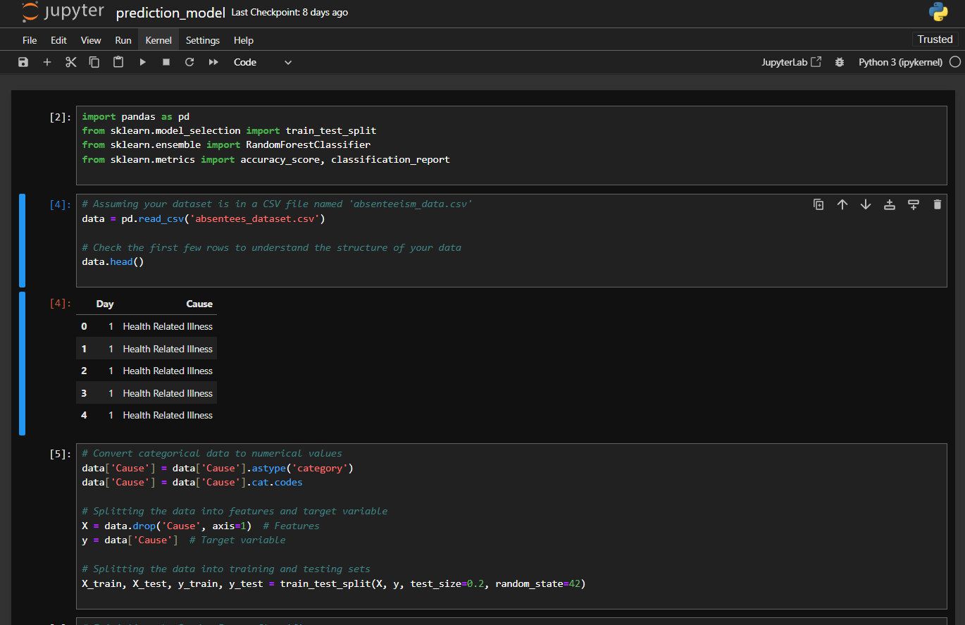

Slide 22
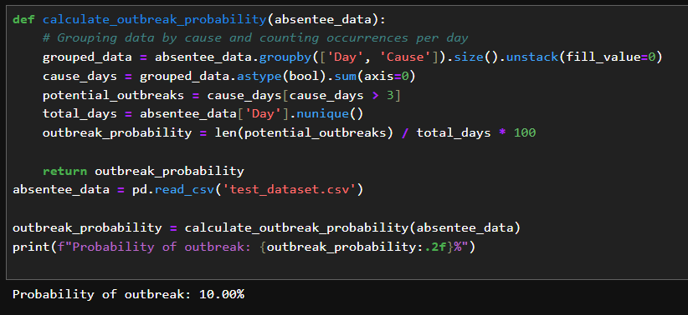

Slide 23
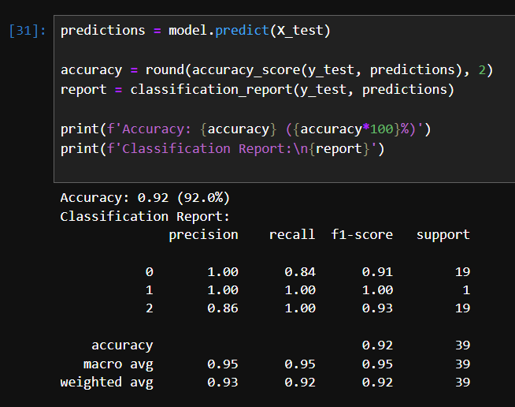

Slide 24
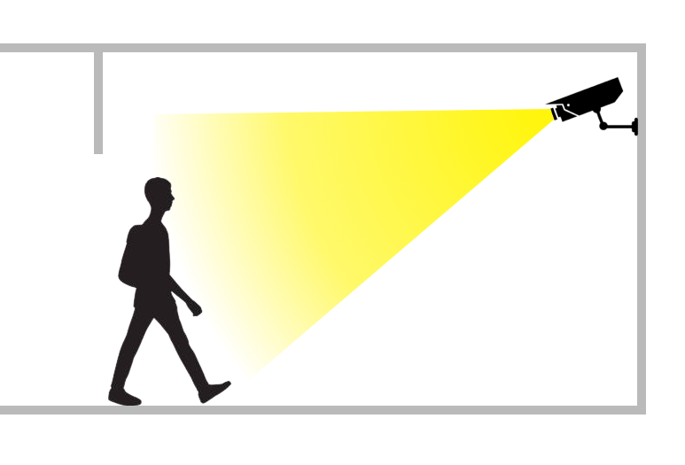
Future Scopes
Using AI cameras to automatically mark the attendance of students using facial recognition technology.

Slide 25

THANK YOU!

